Slide 1
INVENTORY MANAGEMENT
SYSTEM
Y.G. Sanjana : 3BR23CS188
Vanitha .D : 3BR23CS180
V . Lakshmi Geetha :3BR23CS179
Shaik Nabi Sab :3BR23CS145
Shravan Kumar . V :3BR23CS152

Slide 2
Problem:-
The CRUD(create , read , update, delete)product inventory.
Automatic alerts for low stocks.
Reporting capabilities for sales.
Generation of sales reports based on time period
Benefits of CRUD inventory system:-
Efficient stock management :-Real-time updates of product stock levels help businesses avoid both overstock and stock shortages.
Improved Decision-Making :-Sales reports provide key insights that help in demand forecasting and inventory adjustments.
Automated Alerts:-Low stock alerts ensure that critical inventory levels are maintained , preventing stockouts and missed sales opportunities.

Slide 3
### Pseudocode for Inventory System:
START
CLASS Inventory Item:
- Initialize item with name, quantity, and price.
CLASS Inventory System:
- Method: __init__()
- Initialize an empty list called inventory.
- Method: add_item(item)
- Append the given item to the inventory list.
- Method: update_item(name, quantity, price)
- Update item.quantity and item.price with given values.
- Method: delete_item(name)
- Remove items from inventory where item.name == name.
- Method: check_low_stock(limit)
- Add item to the low_stock_items list
- Method: generate_sales_report(start_date, end_date)
- Calculate total sales by summing item.price * item.quantity for all items in inventory.

Slide 4
3. MAIN FUNCTION: - Initialize an Inventory System object
Prompt user to enter item name, quantity, and price
Add the item to the inventory system using add_item().
Call delete_item() to delete the item from the inventory
Call update_item() to update the specified item.
Call check_low_stock(10) to get a list of items with low stock
Call generate_sales_report(start_date, end_date) to calculate total sales for the specified period.
Print the total sales for the period.
END

Slide 5
### Key Points in the Pseudocode:-
Class Definition:
Two classes: Inventory Item and Inventory System.-
Methods in Inventory System:
add_item(), update_item(), delete_item(), check_low_stock(), and generate_sales_report().-
User Interaction:
The program prompts the user to add items, delete, update, check low stock, and generate a sales report.-
Low Stock Check:- Identifies items with a quantity below a certain limit. - Sales Report:- Calculates total sales from the inventory.

Slide 6
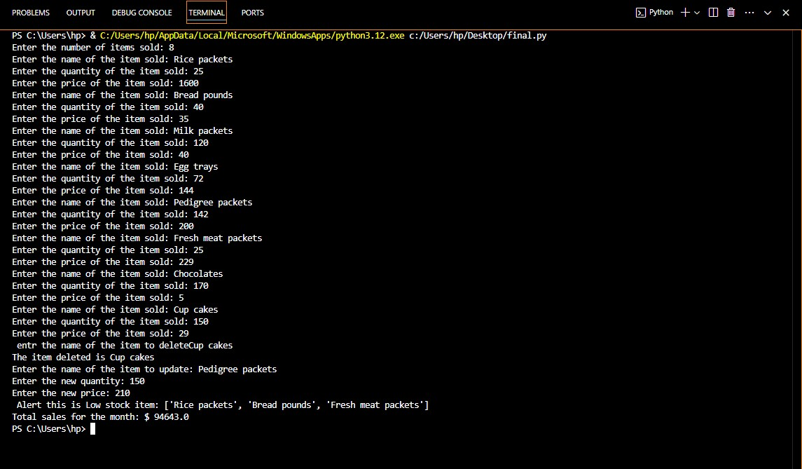

Slide 7
CONCLUSION:-
The project successfully implements an inventory management system using Python. The program allows for the addition, update, and deletion of inventory items, checks for low stock alerts, and generates sales reports for a specific time period. This project showcases the practical application of programming concepts in a real-world scenario, aiding in efficient inventory control and sales analysis.

